Slide 1

Microservices and
Deploying Methodologies
1

Slide 2

Monolithic Applications
Traditional way to build enterprise app, and deployed and scaled as a single package
Main Components:
Client-side user interface
Server-side application
Design Pattern(Services & Repositories)
A database server

Slide 3




Monolithic Application
Scaling and deployed as a single package
Services
Repositories
Data Store
Business Layer
User Interface

Slide 4
Monolithic Application: Example
 | Markets market_id market_name
A query to get the list of products and market name of the logged in user say with id=40 under price 300?
SELECT product_name, market_name FROM products
INNER JOIN markets on products.maket_id = markets.id INNER JOIN users on users.market_id = markets.id WHERE users.user_id = 40
AND products.product_price < 300
 | Products product_id product_name product_price market_id
 | Users user_id user_name market_id

Slide 5
Monolithic Application - MVP version
What if a big hit?
Dev Team 1

Slide 6
Monolithic Application - After few releases
Dev Team 4
Dev Team 3
Areas where multiple teams working on same part
Dev Team 1
Dev Team 2

Slide 7


Monolithic - Pros / Cons
Simple to develop, for small codebases
Not ideal for growing codebase.
Simple to deploy and scale
Pros & Cons
Slower release for large code base
Simple to Test
Steep learning curve
IDE-friendly
Barrier to adopting new technologies

Slide 8
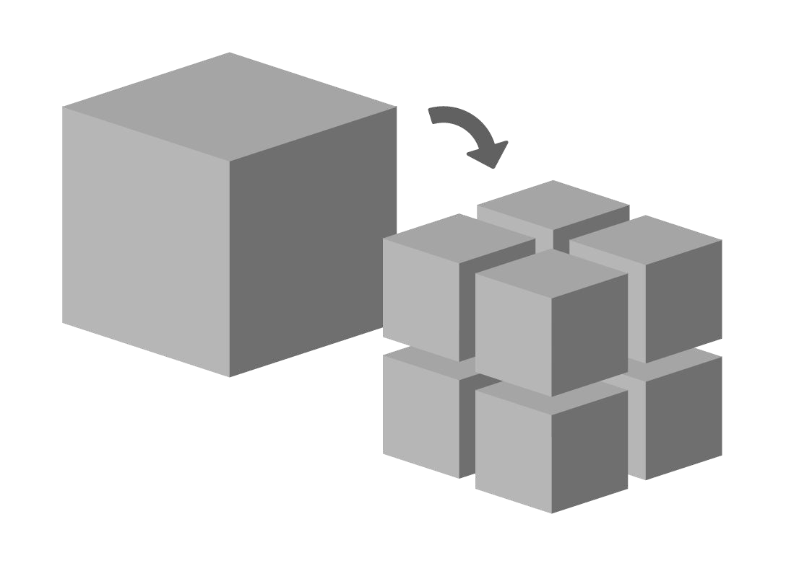
Micro Services
Suites of independently deployable services
Design Considerations
Organized around business capability
Decentralized Database
Loosely Coupled and Highly Cohesive
Independently deployed

Slide 9
Microservice Application
1 Replica
Users Service
API Gateway
Market Service
Products Service
2 Replica
Events

Slide 10
Microservice Application: Example
 | markets { id: 1, name: US, currency: ‘$’, created_at: ‘123’, updated_at: ‘abc’ }
 | products { id: 1, name: ‘AWS’ price: 300, market: { id: 1, name: US } }
 | Users { id: 1, name: ‘John Smith’ market: { id: 1, name: US } }
Separate database per service as per business domain
Maintain Duplicacy of data with single source of truth
Eventual Consistency among services

Slide 11

Microservice - Pros / Cons
Better for complex application
More moving parts
Ease of deployment
Pros & Cons
Harder to Debugging
High scalability
Complex infrastructure
Easy to understand
Documentation overhead

Slide 12
Comparison (Productivity vs Complexity)
Monolithic Microservice
For less complex app managing microservices will leads to extra efforts.
Decoupling nature of microservices really pay off.
Productivity
Complexity

Slide 13
Deployment Challenges with Microservices
Deployment and configuration of high number of services
Update strategy with zero downtime
Scaling of particular services and distribution of traffic
Rollback in case of any trouble
Monitoring of services for node failures
Service Logs and Debugging

Slide 14
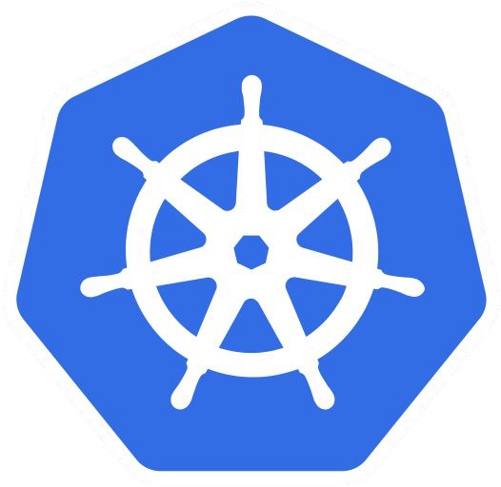

Kubernetes (K8s)
An open-source system for automating deployment, scaling, and management of containerized apps
Why to Choose?
Invented by Google
Managed by open source community
Adopted by Microsoft and Amazon
Run Anywhere

Slide 15
Overview of K8s
20

Slide 16
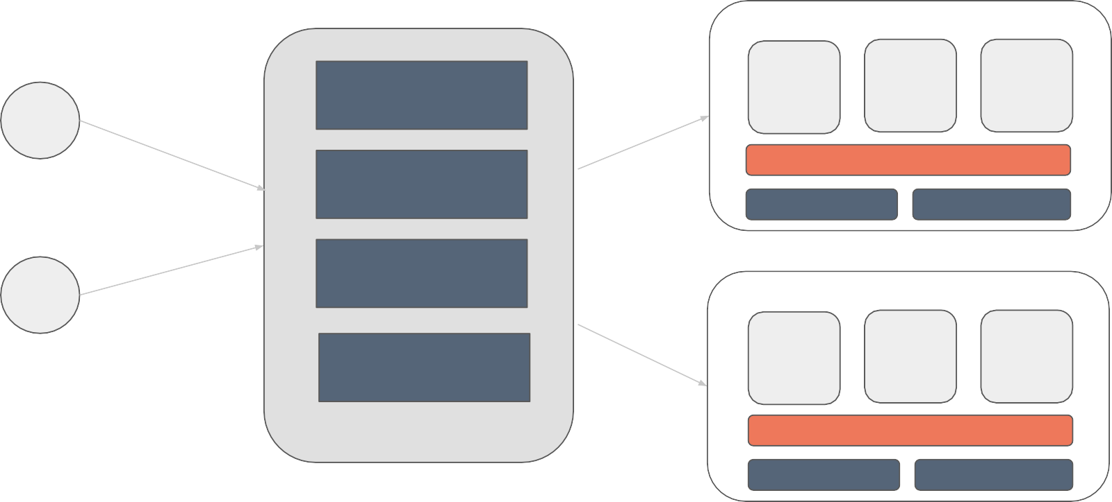
Basic components of Kubernetes (Cloud)
Cluster
Worker Node 1
Pod 1 Pod 2
Master Node
Pod N
Dashboard
API Server
UI
docker
kube-proxy
Scheduler
kubelet
Worker Node N Pod 2
Controller Manager
CLI
Pod 1
Pod N
Kubectl
etcd
docker
kube-proxy
kubelet

Slide 17
Basic components of Kubernetes (local)
Minikube
Dashboard
Master Node
Single Worker Node
Pod 1 Pod 2 Pod N
UI
docker
kube-proxy
CLI
kubelet
Kubectl
Local Cluster

Slide 18
Basic components: Pods
Worker Node
Containers
Pod 1
Pod 2
Pod N
Basic and smallest building block.
All the connected containers deployed to a single pod
Containers inside pod will live and die together
All containers have common IP, and resources.
Each POD has unique IP.
User
Product
Report
Log
Log
docker
kubelet
kube-proxy

Slide 19

Basic components: Deployments
Deployment
Replica Set Replica: 2
Scaling up and down of the pods.
Manages releases and rollback
Self Healing of system
Assign a unique label to every set of pods, and used by services for discovery.
Pod
Pod
User
User
Log
Log
label=user-service
label=user-service

Slide 20
Basic components: Service
Deployment
Replica Set Replica: 2
Stable endpoint that load balances traffic among pods with similar label
Discover the respective pods by the selectors
With Service you don’t have to remember how many pods are running or where
Pod
Pod
label=user-service
label=user-service
Service
selector: user-service

Slide 21
Basic components: Ingress
Public IP
Service: ingress
-Path: /users Service: user-service
-Path: /markets
Type: LoadBalancer
Service: market-service
-Path: /products
Service: product-service
Pod Ingress
Controller
Service: user-service
Service: market-service
Service: product-service
Type: NodePort
Type: NodePort
Type: NodePort
Pod A
label: user-service
Pod B
label: user-service
Pod C
label: market-service
Pod D
label: product-service
Pod E
label: product-service

Slide 22
K8s: Rollbacks
Rolling out your application to previous version
Set the revision that you want
Kubernetes will scale up the corresponding ReplicaSet, and scaled down the current one
Handy Commands:
kubectl rollout history deployments products
kubectl rollout status deployments products
kubectl rollout undo deployments products

Slide 23
Deployment Strategies: Rolling Updates
V1
V1
V1
V1
V2
V1
V1
`
V2
V1
`
V2
`
V2
V2
`
V2
V1
V1
V1
V2
V2
Replace each pod in the deployment with a new one
Backwards compatibility
New ReplicaSet created and old ones gets decreased

Slide 24
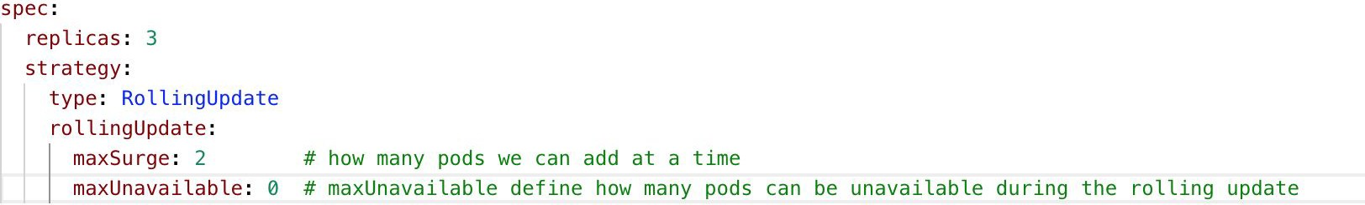
Deployment Strategies: Rolling Updates (example)

Slide 25

Deployment Strategies: Recreate Strategy
V1
V1
V2
V1
`
V1
V1
`
V1
V2
`
V2
V1
V1
V2
Terminate the old version and release the new one

Slide 26
Deployment Strategies: Blue/Green
V1
V1
V1
V1
V1
V2
V1
V2
V2
V2
V2
V2
Run two complete deployments of your application
“green” version of the application is deployed alongside the “blue” version

Slide 27
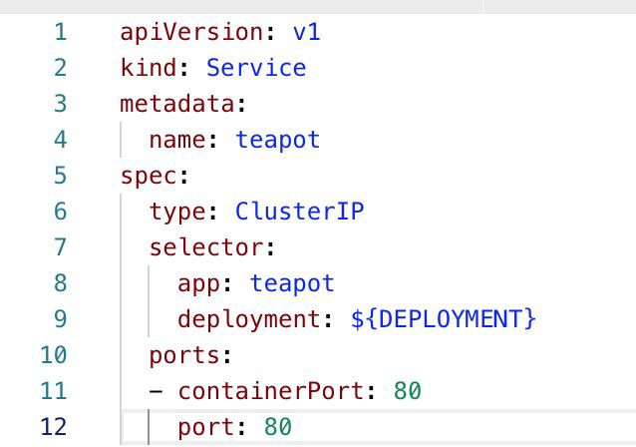
Deployment Strategies: Blue/Green (example)

Slide 28

Minikube: K8s cluster on Local
Minikube
Master Node
Dashboard
Single Node
API
Server
UI
Pod 1 Pod 2 Pod N
Scheduler
Controller Manager
docker
CLI
kubelet
kube-proxy
Kubectl
etcd
Local Cluster

Slide 29
Minikube: Prerequisites
VM Driver
macOS: VirtualBox, VMware Fusion, HyperKit
Linux: VirtualBox, KVM
Windows: VirtualBox, Hyper-V
Install Minikube
brew cask install minikube (macOS)
Install kubectl
VT-x/AMD-v virtualization must be enabled in BIOS
Internet connection on first run
Few handy commands:
minikube start (pass VM option), default is VirtualBox
minikube addons enable ingress

Slide 30
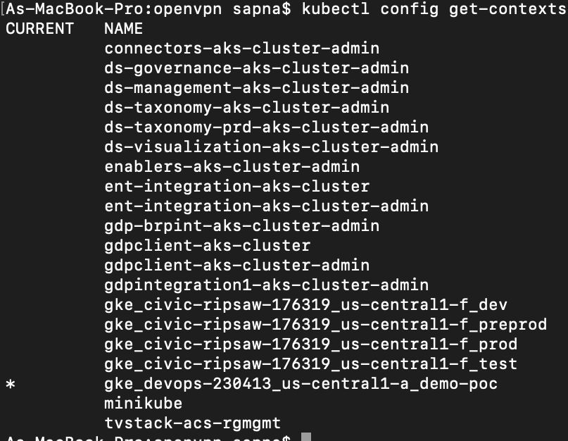
Minikube: K8s Cluster
Hurrah! Now we have K8s cluster running named as minikube
kubectl config get-contexts

Slide 31
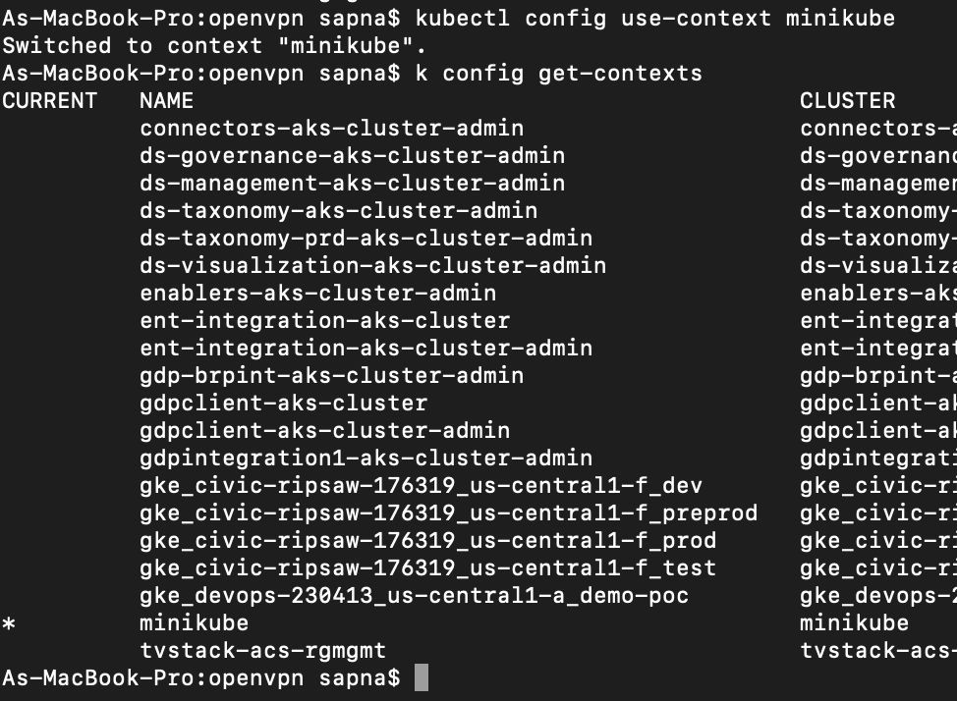
Minikube: K8s Cluster
Change context to minikube
kubectl config use-context minikube
kubectl config get-contexts

Slide 32
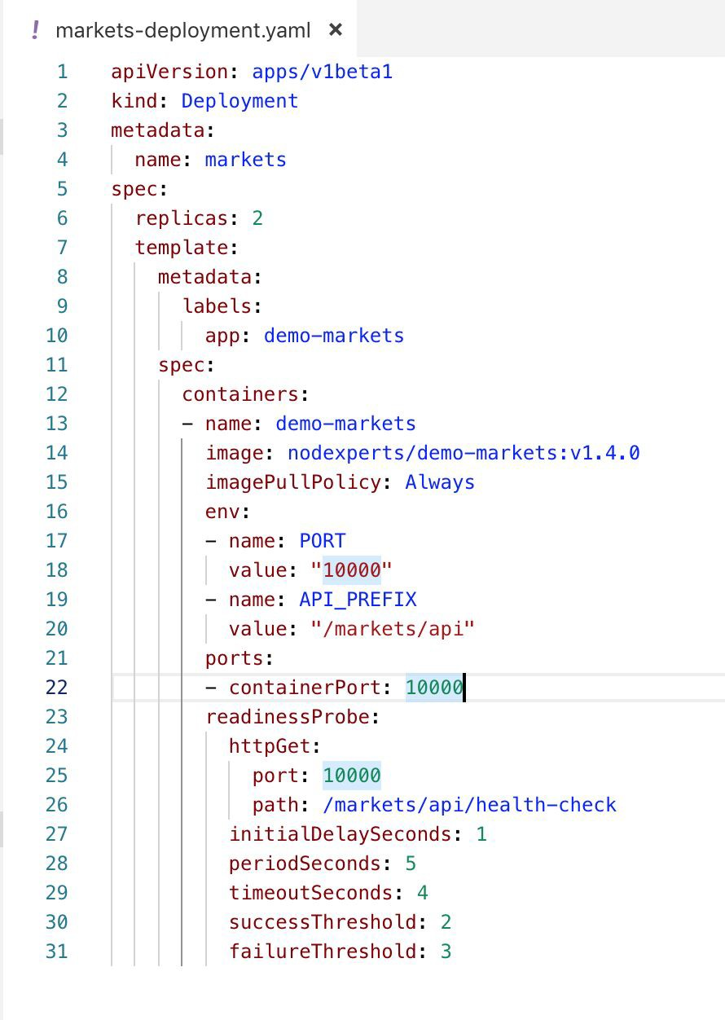
Minikube: Deployment (Markets Service)
Container Port is the port that the application is running on.
Readiness probes: when a Container is ready to start accepting traffic.
A Pod is considered ready when all of its Containers are ready

Slide 33
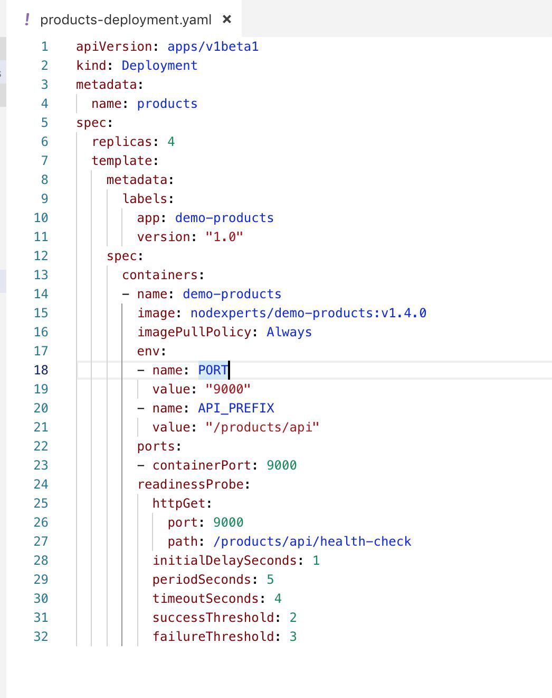
Minikube: Deployment (Products Service)
A Deployment named demo-product is created
four replicated Pods
Pods are labeled as demo-products
Image from docker
Environment variables

Slide 34
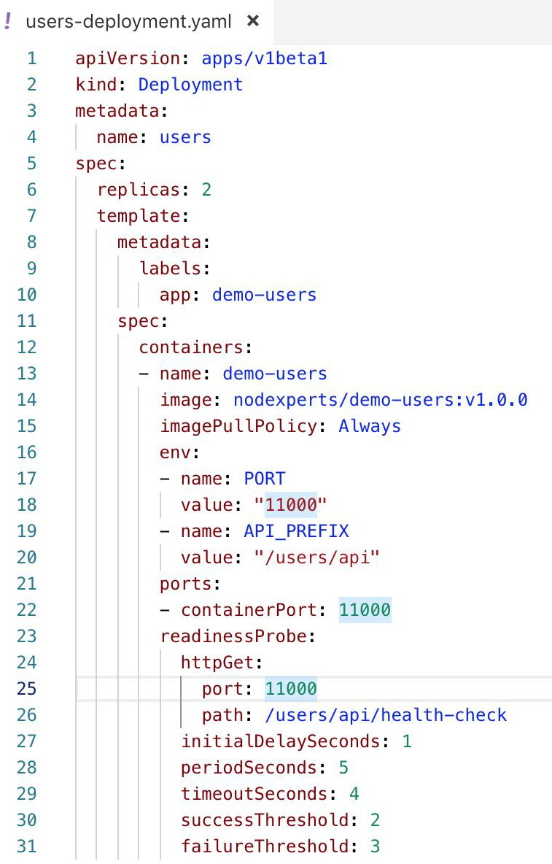
Minikube: Deployment (Users Service)
A Deployment named demo-users is created
Two replicated Pods
Pods are labeled as demo-users
Image from docker
Environment variables

Slide 35
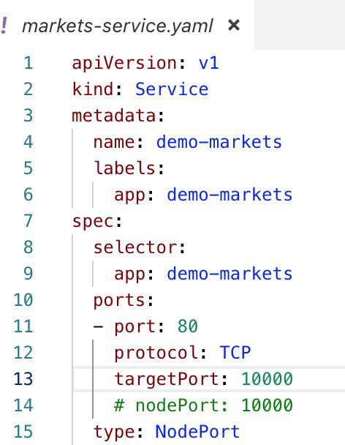
Minikube: Service (Markets Service)
Each Pod has a unique IP address, those IPs are not exposed outside the cluster without a Service
demo-markets service Selects demo-markets Pods

Slide 36
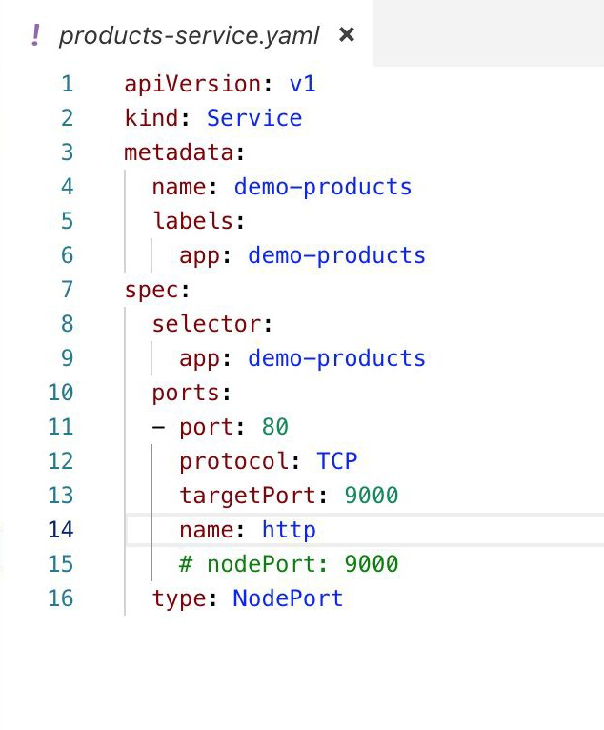
Minikube: Service (Products Service)
Each Pod has a unique IP address, those IPs are not exposed outside the cluster without a Service
demo-products service Selects demo-products Pods

Slide 37
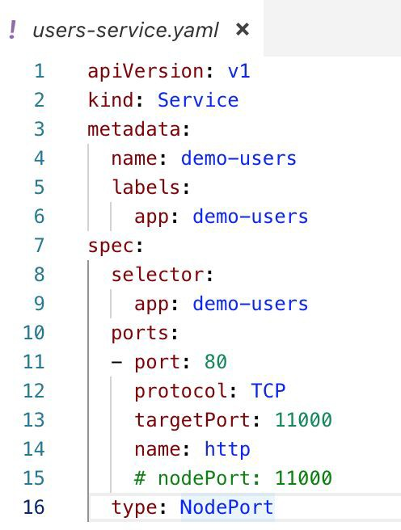
Minikube: Service (Users Service)
Each Pod has a unique IP address, those IPs are not exposed outside the cluster without a Service
demo-users service Selects demo-users Pod

Slide 38
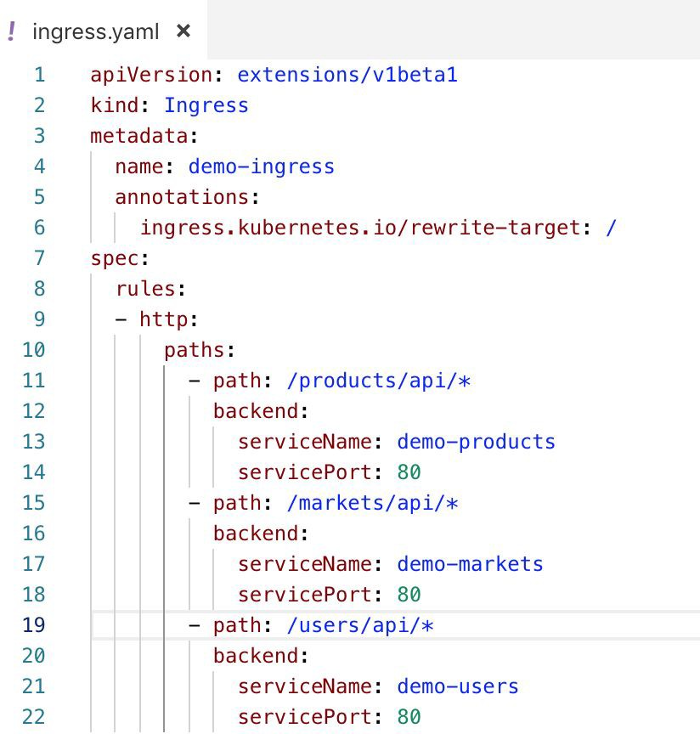
Minikube: Ingress
Ingress objects are the rules that define the routes that should exist.
Annotations to configure some options depending on the Ingress controller
Target URI where the traffic must be redirected

Slide 39
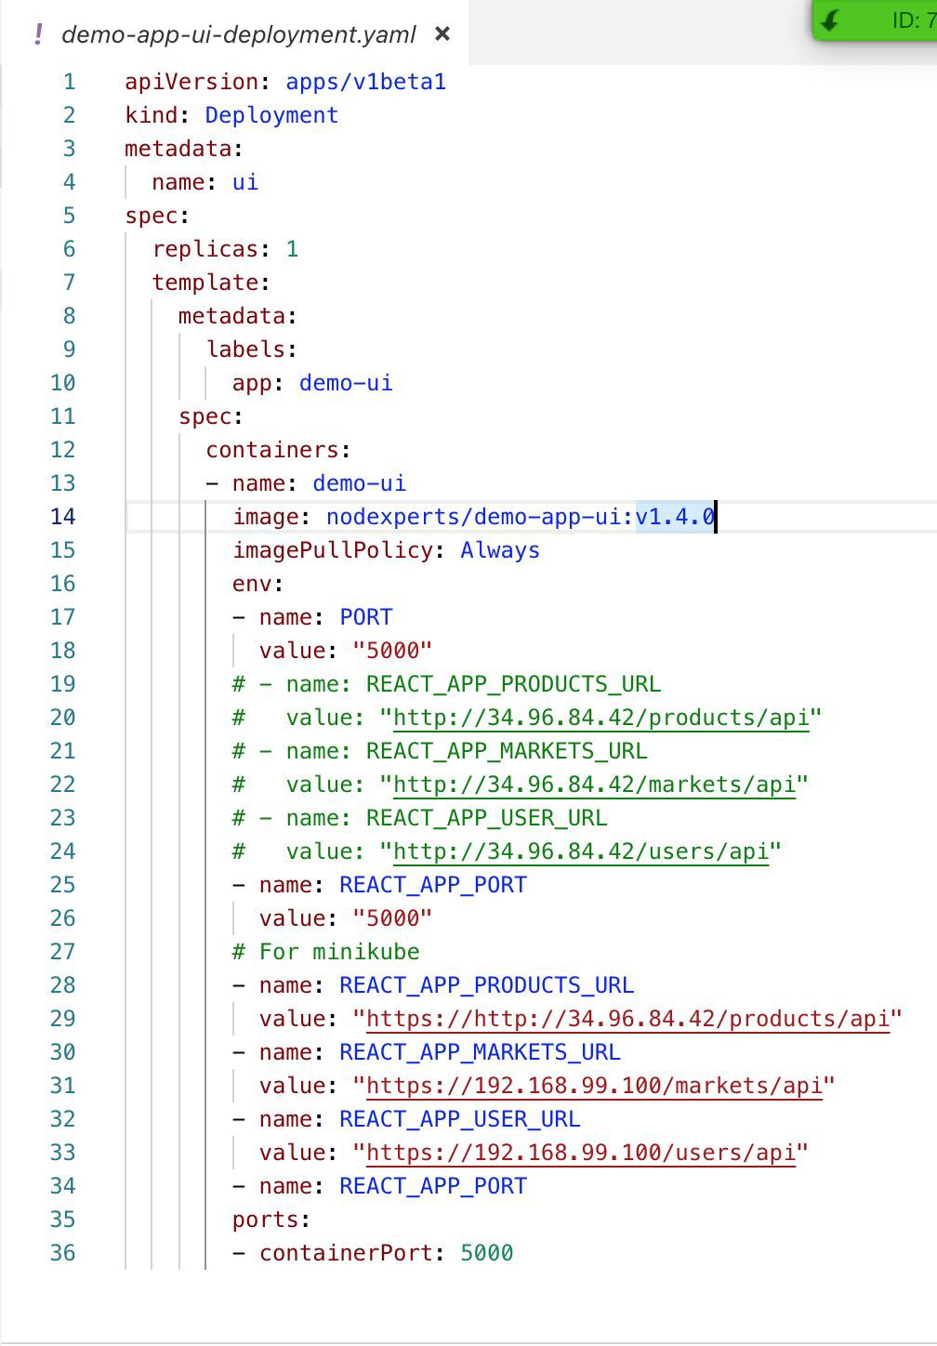
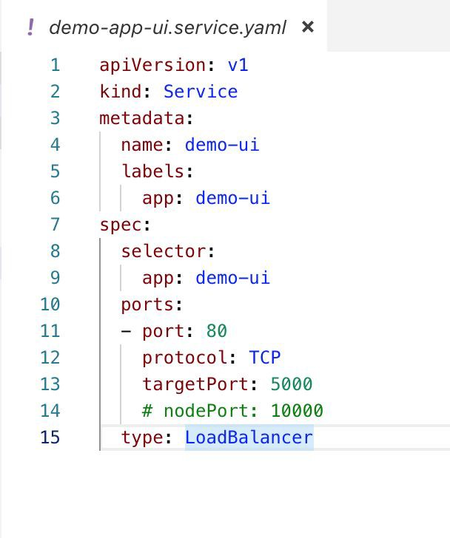
Minikube: UI Deployment and Service

Slide 40


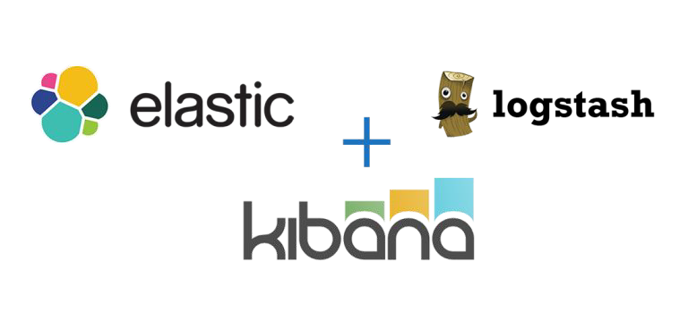

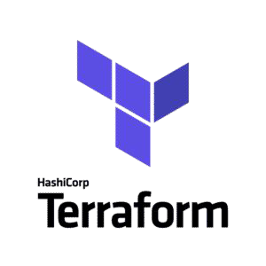



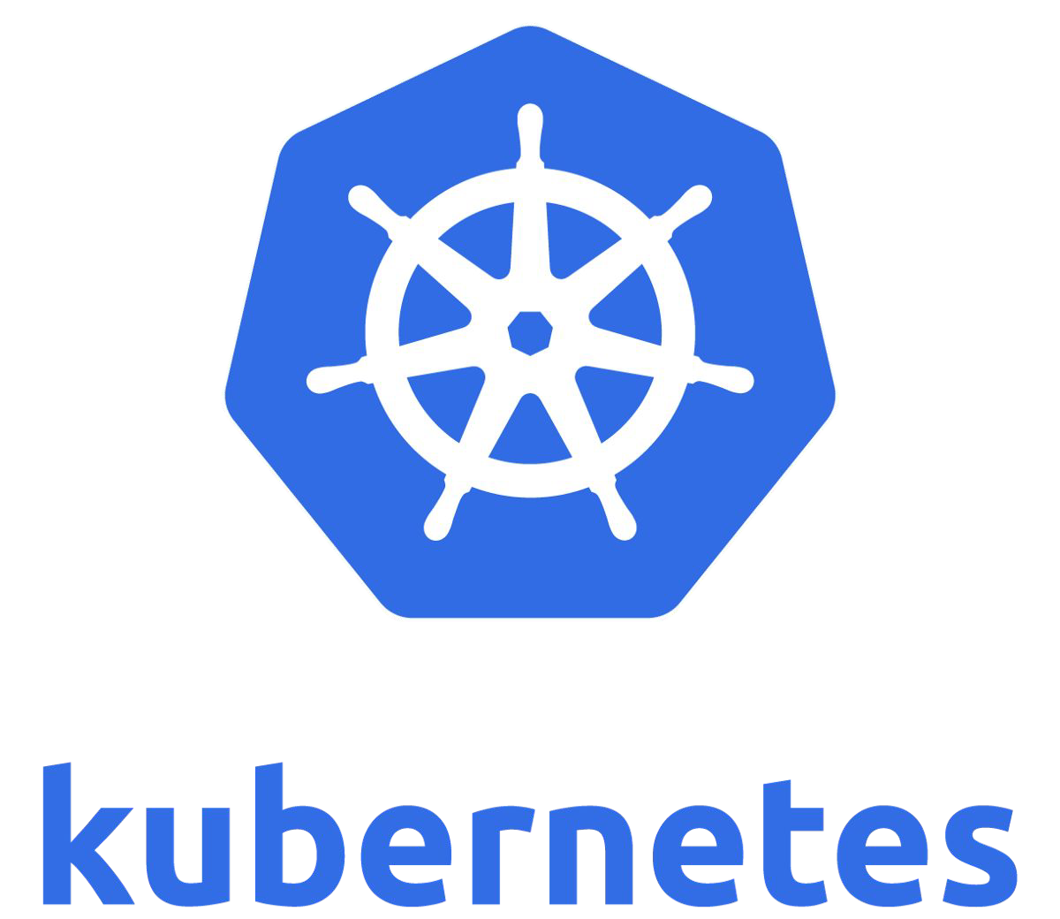
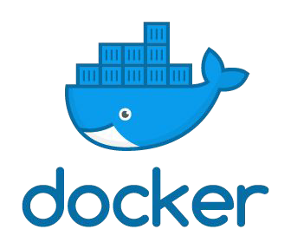





Clouds and Tools
We at Successive Technologies use following tools for building Cloud Agnostic Platform.

